Slide 1
SPLASH Water Safety Campaign 2017
Law Enforcement Off the Pavement

Slide 2
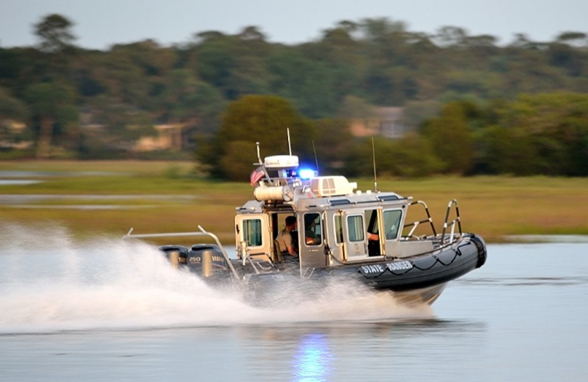
SPLASH
SPLASH Water Safety Campaign

Slide 3
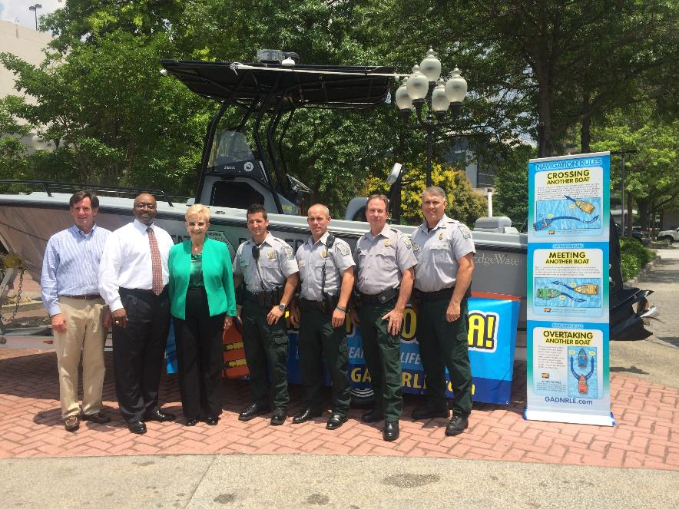
Campaign History
First Lady Sandra Deal kicks off her all encompassing SPLASH water safety campaign 2017!

Slide 4
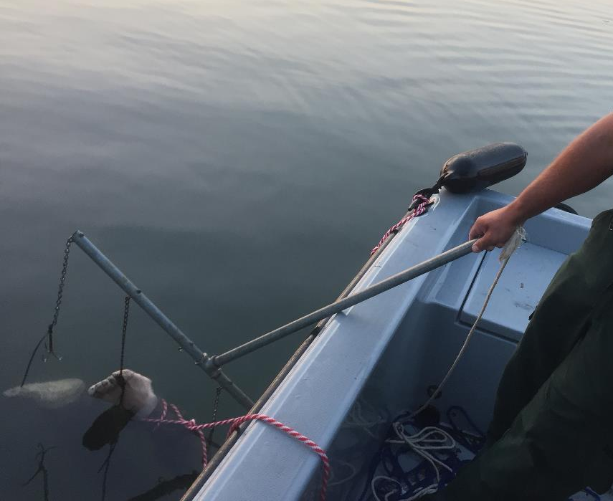
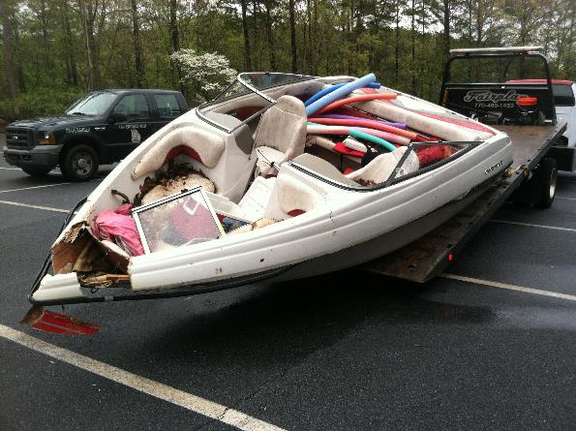
A Decade of Water Deaths
Georgia Water Deaths 2007 – 2016
Boating Fatalities 163
Drownings 438
TOTAL 601

Slide 5
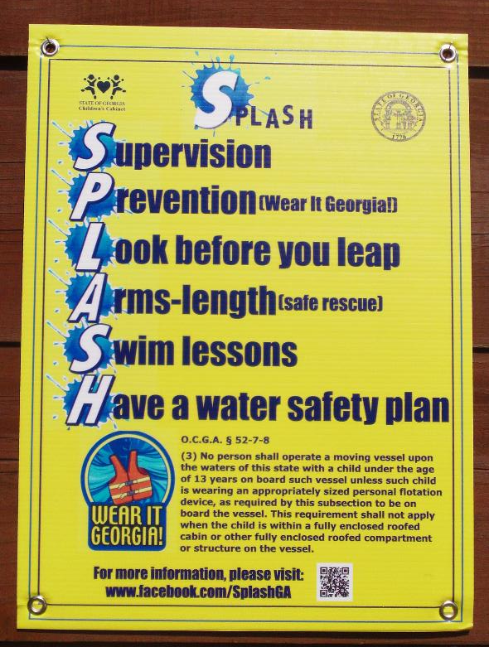
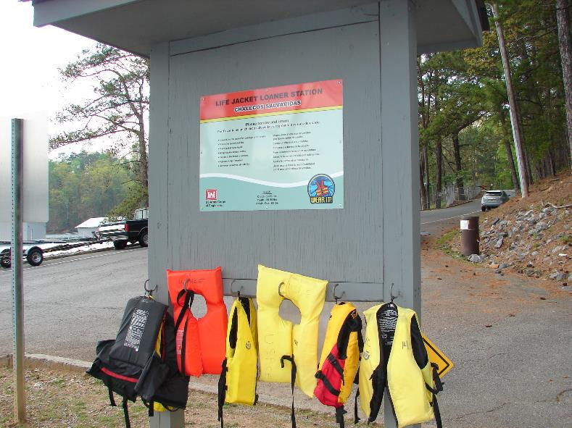
The Campaign
A campaign to encourage boating, swimming, and overall water safety!

Slide 6
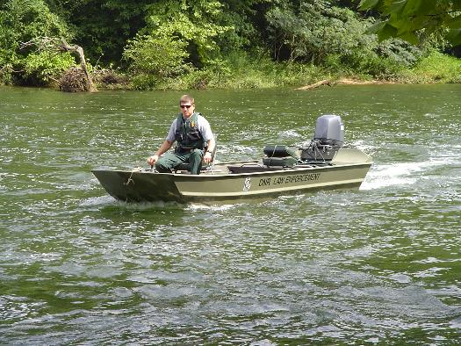
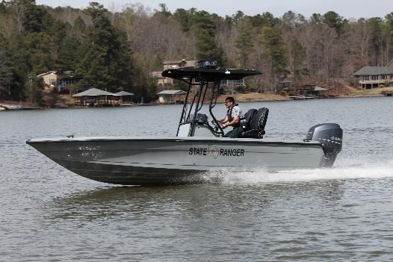
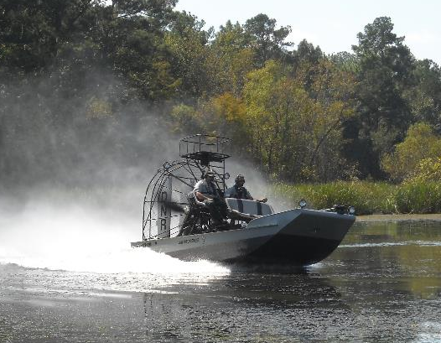
DNR LED on Patrol
Game Wardens actively patrol Georgia’s waterways from the smallest of rivers, to inland waterways and reservoirs, to the coastal ocean.

Slide 7
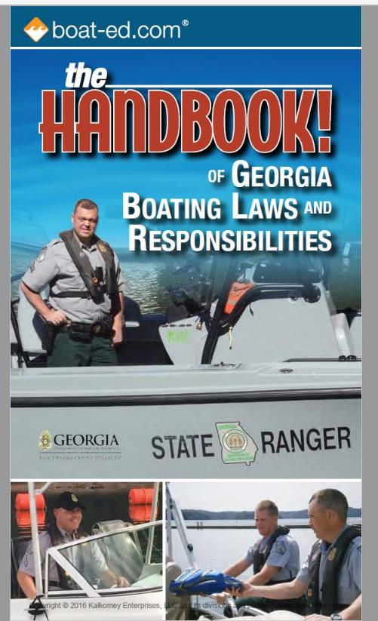
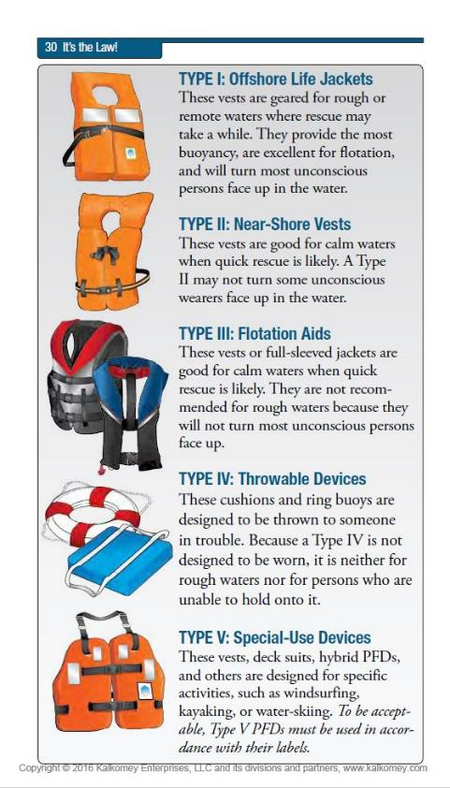
Life Jackets

Slide 8
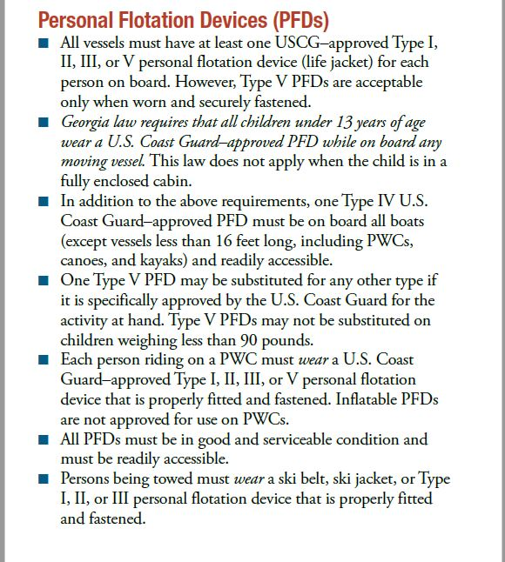
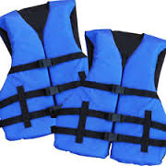
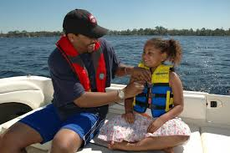
Georgia Law

Slide 9
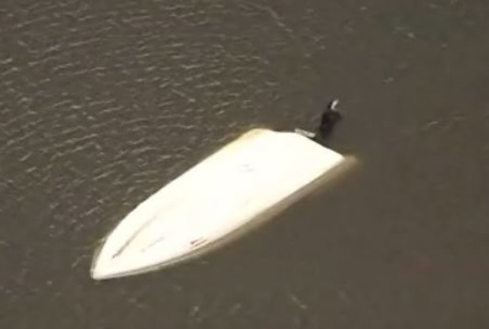
Allatoona Boat Crash
In February 2017, Edward Bentley was the sole survivor of a two vessel crash on Allatoona Lake. The operators of both vessels did not survive. No one was wearing a life jacket. Edward lost his cousin, Ronnie, who was operating this bass boat. His opinion on wearing life jackets……..

Slide 10
Edward Bentley

Slide 11
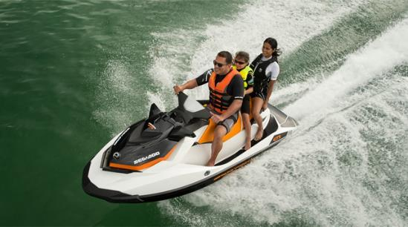
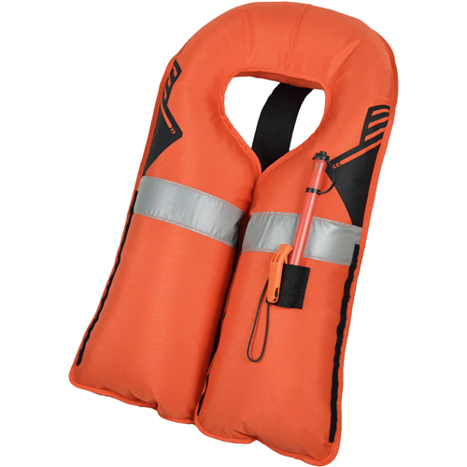
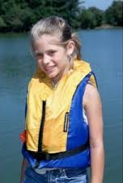
Life Jackets Save Lives
Drownings are the leading cause of death in children ages 1 - 4

Slide 12
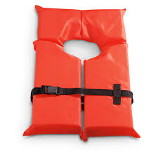
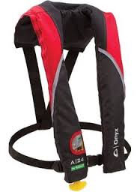
Then & Now
VS.

Slide 13
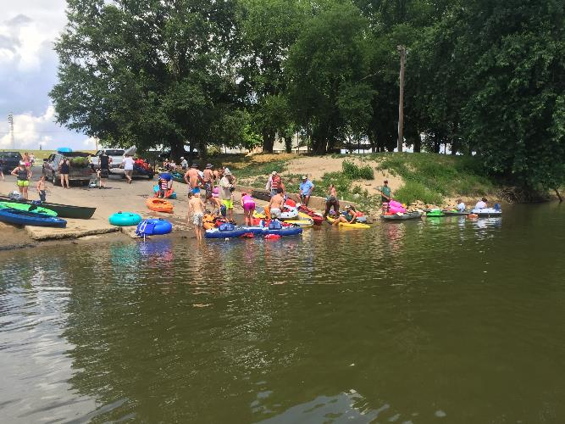
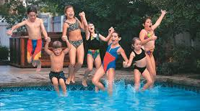
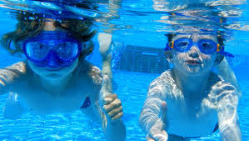
Other Water Deaths
Pools
Hot Tubs
House Tubs
Lake/River Swimming

Slide 14
Swim Safe Kids!
Swimming is a great recreational sport that can be enjoyed by people of all ages. But it’s important to know how to be safe while you’re in the water. The American Red Cross offers these important swimming safety tips you should be aware of before you head out to the pool or beach:
• • Swim in designated areas supervised by lifeguards.
• Always swim with a buddy; do not allow anyone to swim alone.
• Never leave a young child unattended near water and do not trust a child’s life to another child; teach children to always ask permission to go near water.
• Have young children or inexperienced swimmers wear U.S. Coast Guard-approved life jackets around water, but do not rely on life jackets alone.
• Maintain constant supervision.
• Make sure everyone in your family learns to swim well. Enroll in age-appropriate Red Cross water orientation and learn-to-swim courses.
• If you have a pool, secure it with appropriate barriers. Many children who drown in home pools were out of sight for less than five minutes and in the care of one or both parents at the time.
• Avoid distractions when supervising children around water.
• If a child is missing, check the water first. Seconds count in preventing death or disability.
• Have appropriate equipment, such as reaching or throwing equipment, a cell phone, life jackets and a first aid kit.
• Know how and when to call 9-1-1 or the local emergency number.
• Enroll in Red Cross home pool safety, water safety, first aid and CPR/AED courses to learn how to prevent and respond to emergencies.
• Protect your skin. Limit the amount of direct sunlight you receive between 10:00 a.m. and 4:00 p.m. and wear sunscreen with a protection factor of at least 15.
• Drink plenty of water regularly, even if you’re not thirsty. Avoid drinks with alcohol or caffeine in them.

Slide 15
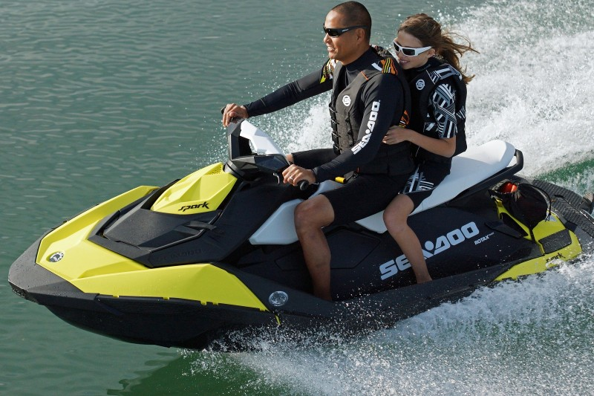
Life Jackets are Cool!

Slide 16
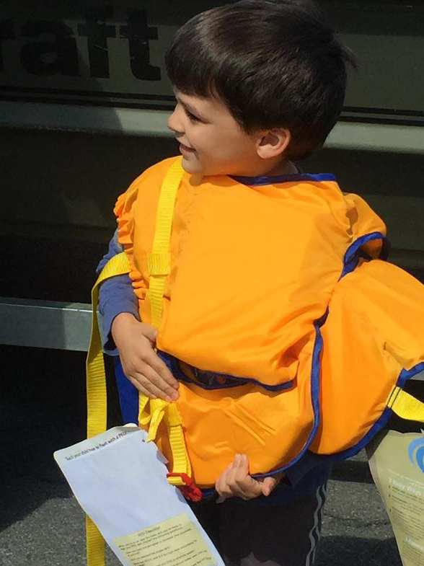
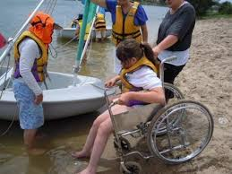
Who Needs to Wear It?
Marginal Swimmers
Children
Younger/Older Generation
Disabled
Safety-minded

Slide 17
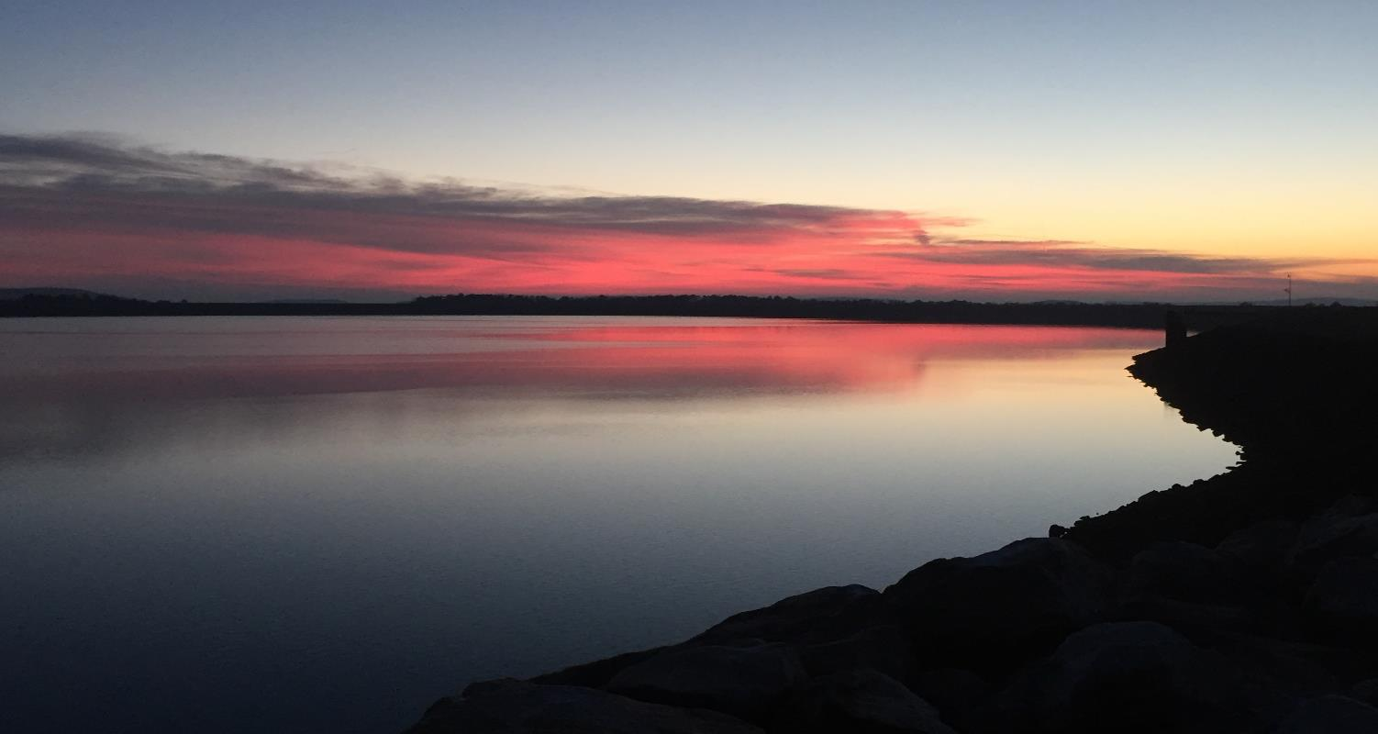
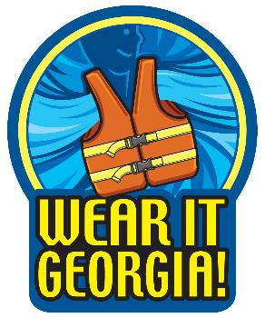
Wear It Georgia!

Slide 18
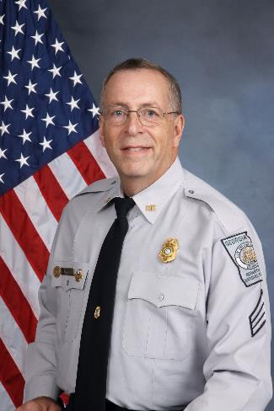
Questions?
Sergeant Mike Barr
Region I - Acworth
Office: (770) 529-2424
Mobile: (404) 520-3322
Mike.Barr@dnr.ga.gov

